Slide 1
Needfinding
Informative Visualization
Max Freundlich
Kristen Law
Elisa Lupin-Jimenez
Notes:
Going into the needfinding process and brainstorming domains we were interested in, we had the idea to use AR to give users more information about their surroundings. We wanted to see if we could enhance their perception of the world around them
For example: Helping consumers understand the products they’re buying before they buy it (via barcode scanning to bring up reviews, etc.)

Slide 2
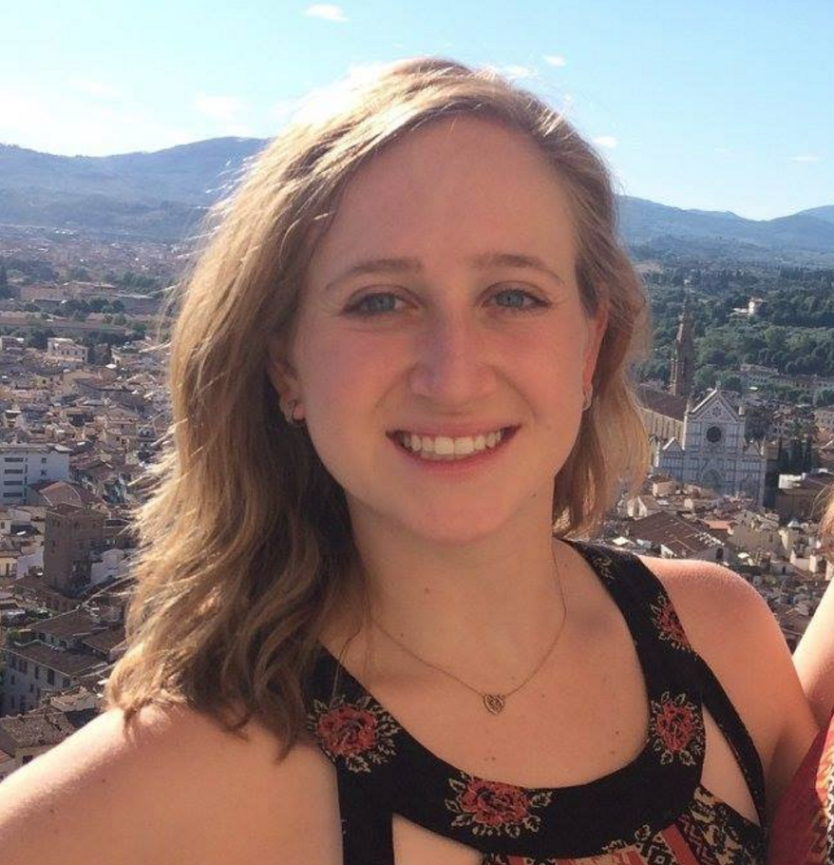
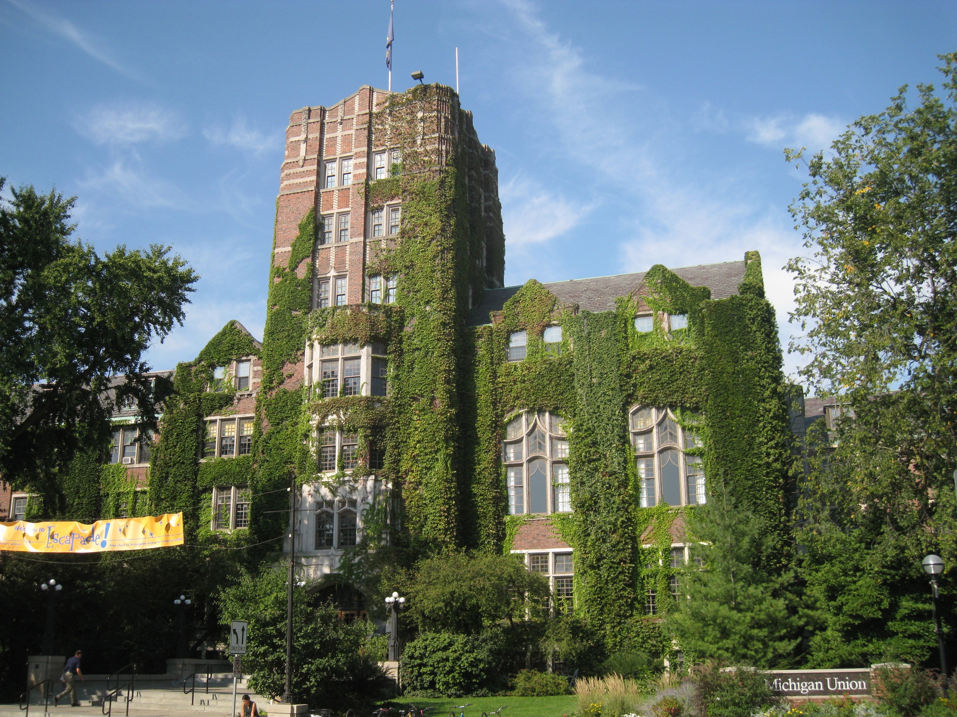
Mollie Fox
Art History Major
University of Michigan
Notes:
Why we chose Chrystal: Med school is a ton of memorization and hard work. They do a ton of hands on work with donated bodies to understand human anatomy. Since this process is so visual, we thought that she would be a perfect person to interview.
We talked in depth with chrystal about studying cadavers. We asked her how difficult it was to associate imaged in a textbook with the real thing. We asked her about how she studies and how she is able to memorize every small detail.

Slide 3
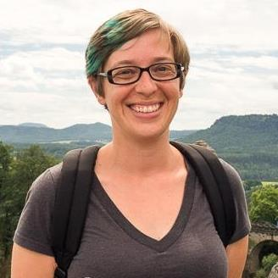
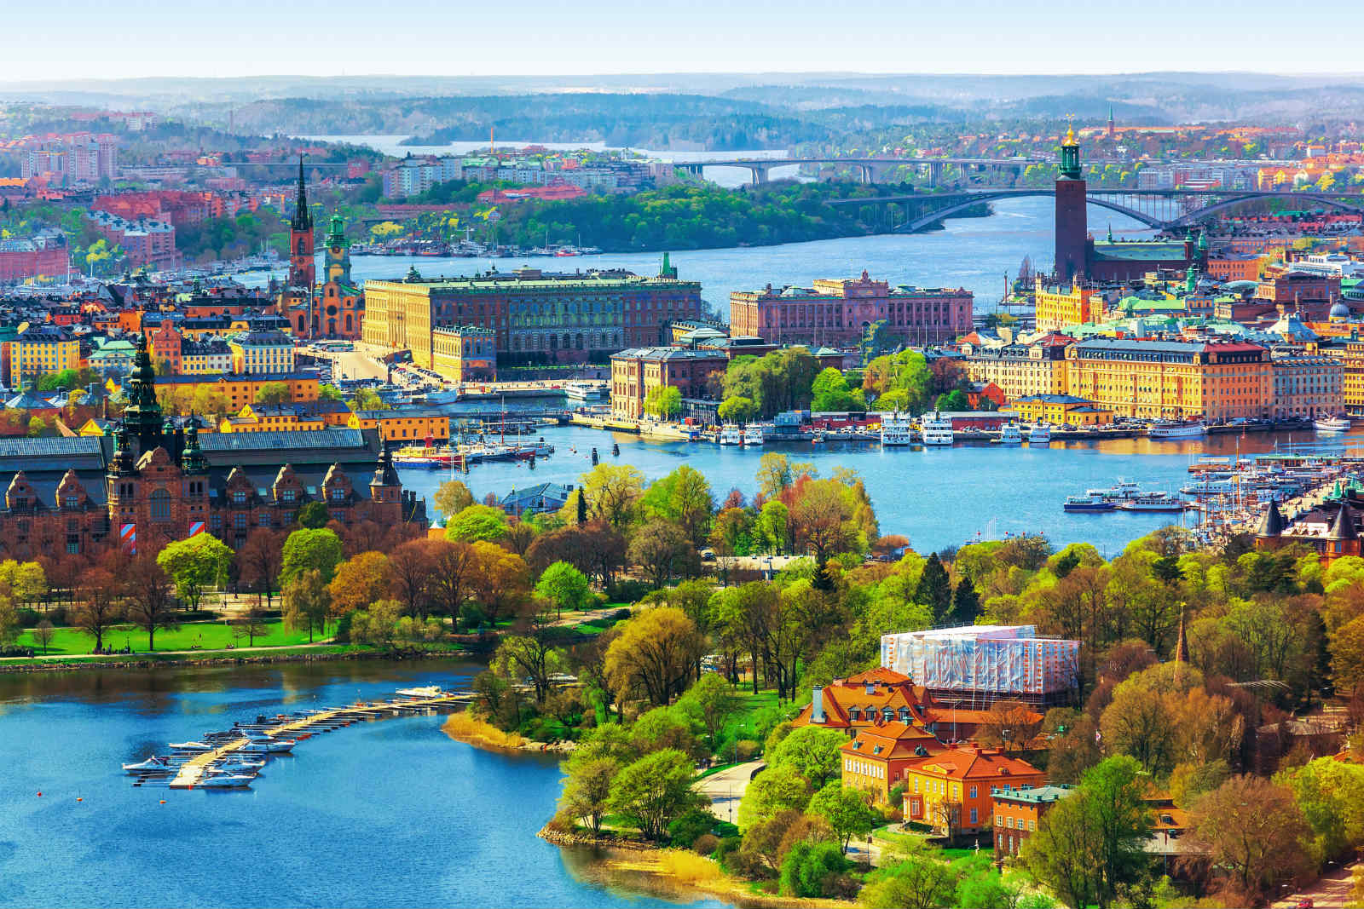
Amber Wilkie
Photographer/Programmer
Sweden
Notes:
Why we chose Amber: She is a wedding photographer who built her business from scratch and trained herself. She talked about taking initiative and her struggle to find direction when in an unfamiliar setting, whether that be in photography, business, or Sweden.

Slide 4
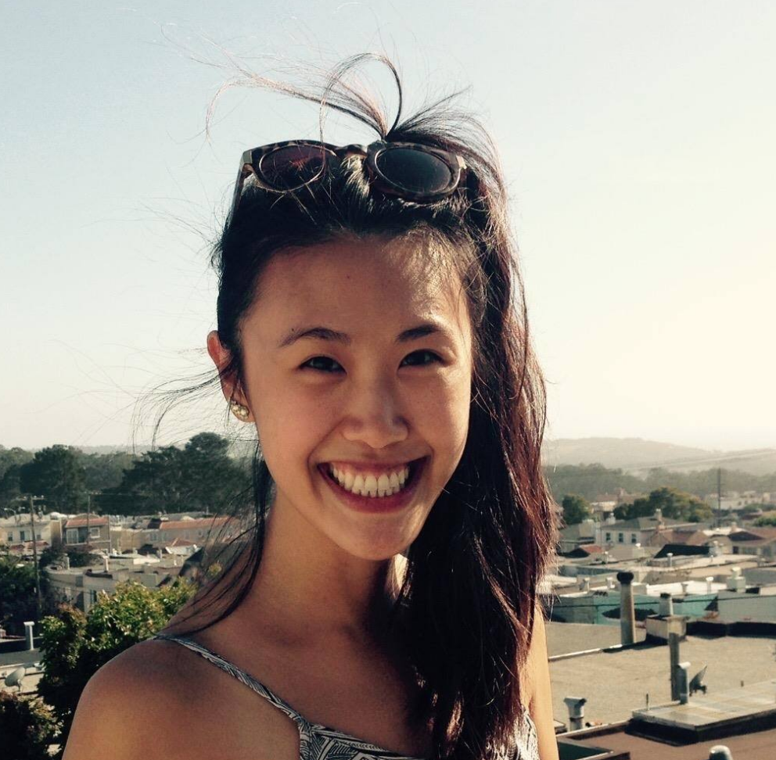
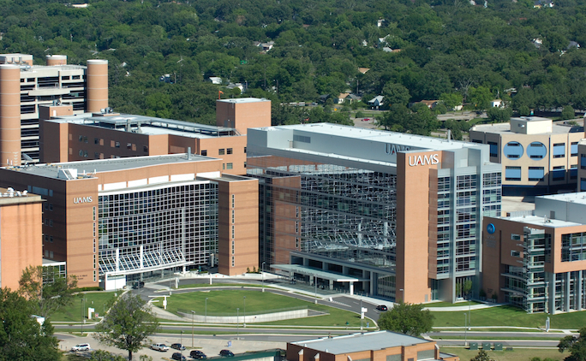
Chrystal Lau
Med school student
Arkansas
Notes:
Why we chose Chrystal: Med school is a ton of memorization and hard work. They do a ton of hands on work with donated bodies to understand human anatomy. Since this process is so visual, we thought that she would be a perfect person to interview.
We talked in depth with chrystal about studying cadavers. We asked her how difficult it was to associate imaged in a textbook with the real thing. We asked her about how she studies and how she is able to memorize every small detail.

Slide 5
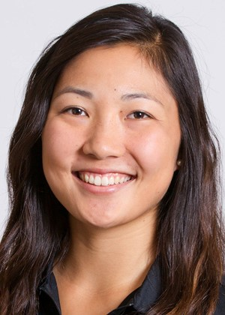

Lauren Kim
Professional Golfer
Palo Alto
Notes:
Why we chose Lauren: Golf requires a great deal of visualization. You need to understand how each hole is situated on the green as well as how the green slopes. Its important to know the layout of the course prior to a tournament so you don’t have any surprises.
We asked Lauren a lot about her process of getting into “ the zone” prior to every tournament. We asked how she visualizes each hole and why it is so important. We asked about how she handles stress and what she thinks about to get through tough games.

Slide 6
Interview Results

Slide 7
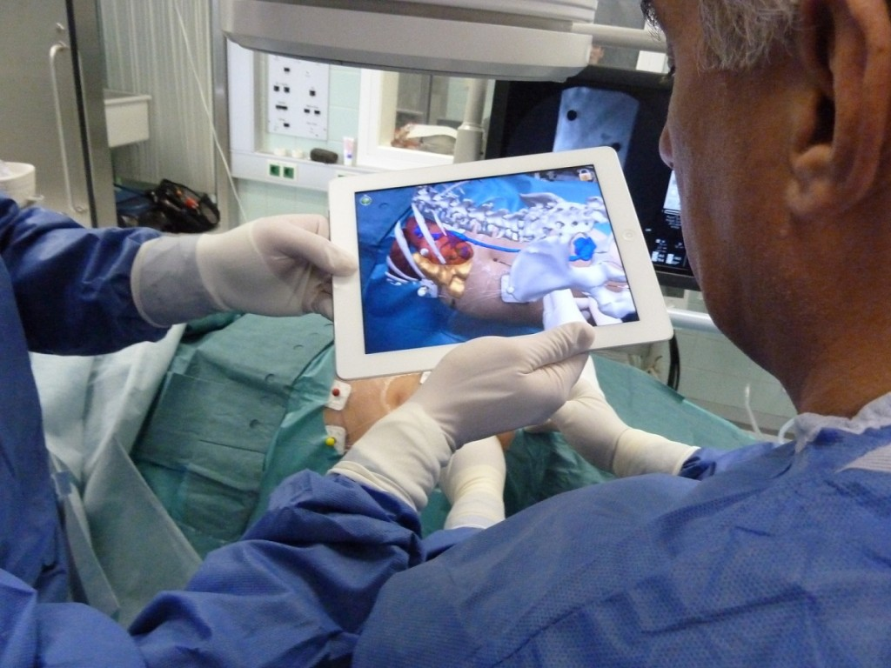
Our Findings
Visualization
Anatomy
Design inspiration
Golf course
Guidance
Lost in a new place
Own boss
Initial push
Notes:
Golfer wanted to visualize course prior to playing
Med student wanted to visualize the body parts she was studying
Art student found the design process challenging, and having some sort of visualization that acts as inspiration could be helpful.

Slide 8
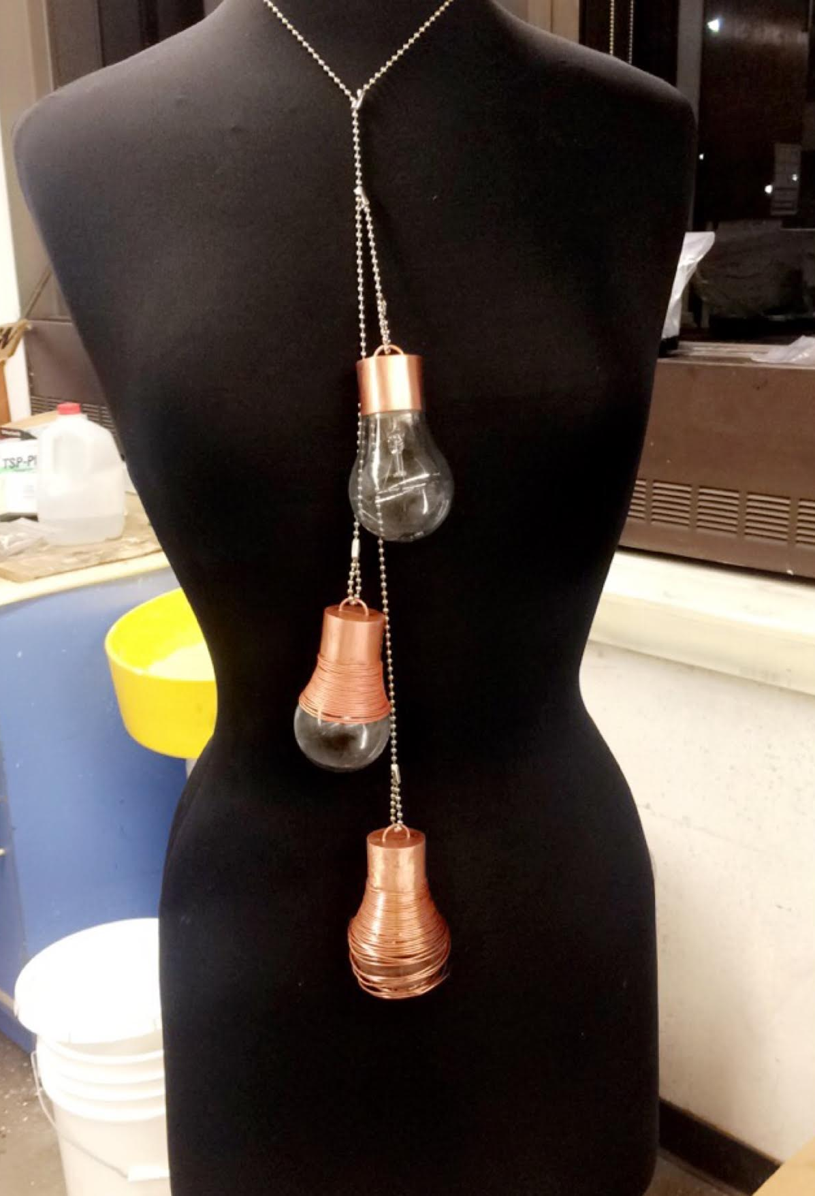
Tensions
“High school cliques” - Chrystal
Balance between social life and golf - Lauren
Foreign environment - Amber
Struggle to convey idea - Mollie

Slide 9

Contradictions
Discrepancy in practice hours - Lauren
“Sweden is not all that different culturally from the states” - Amber
Notes:
Said a professional golfer should practice 6-7 hours a week and that she has all day to practice, but she only practices 4.5-5 hours

Slide 10
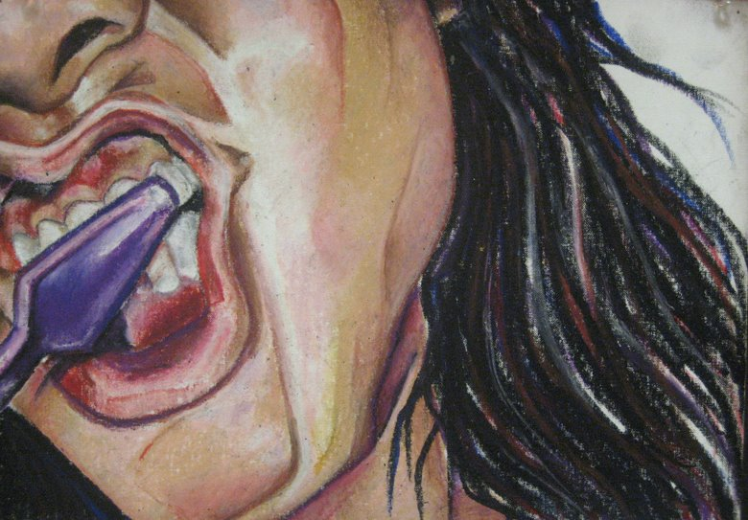
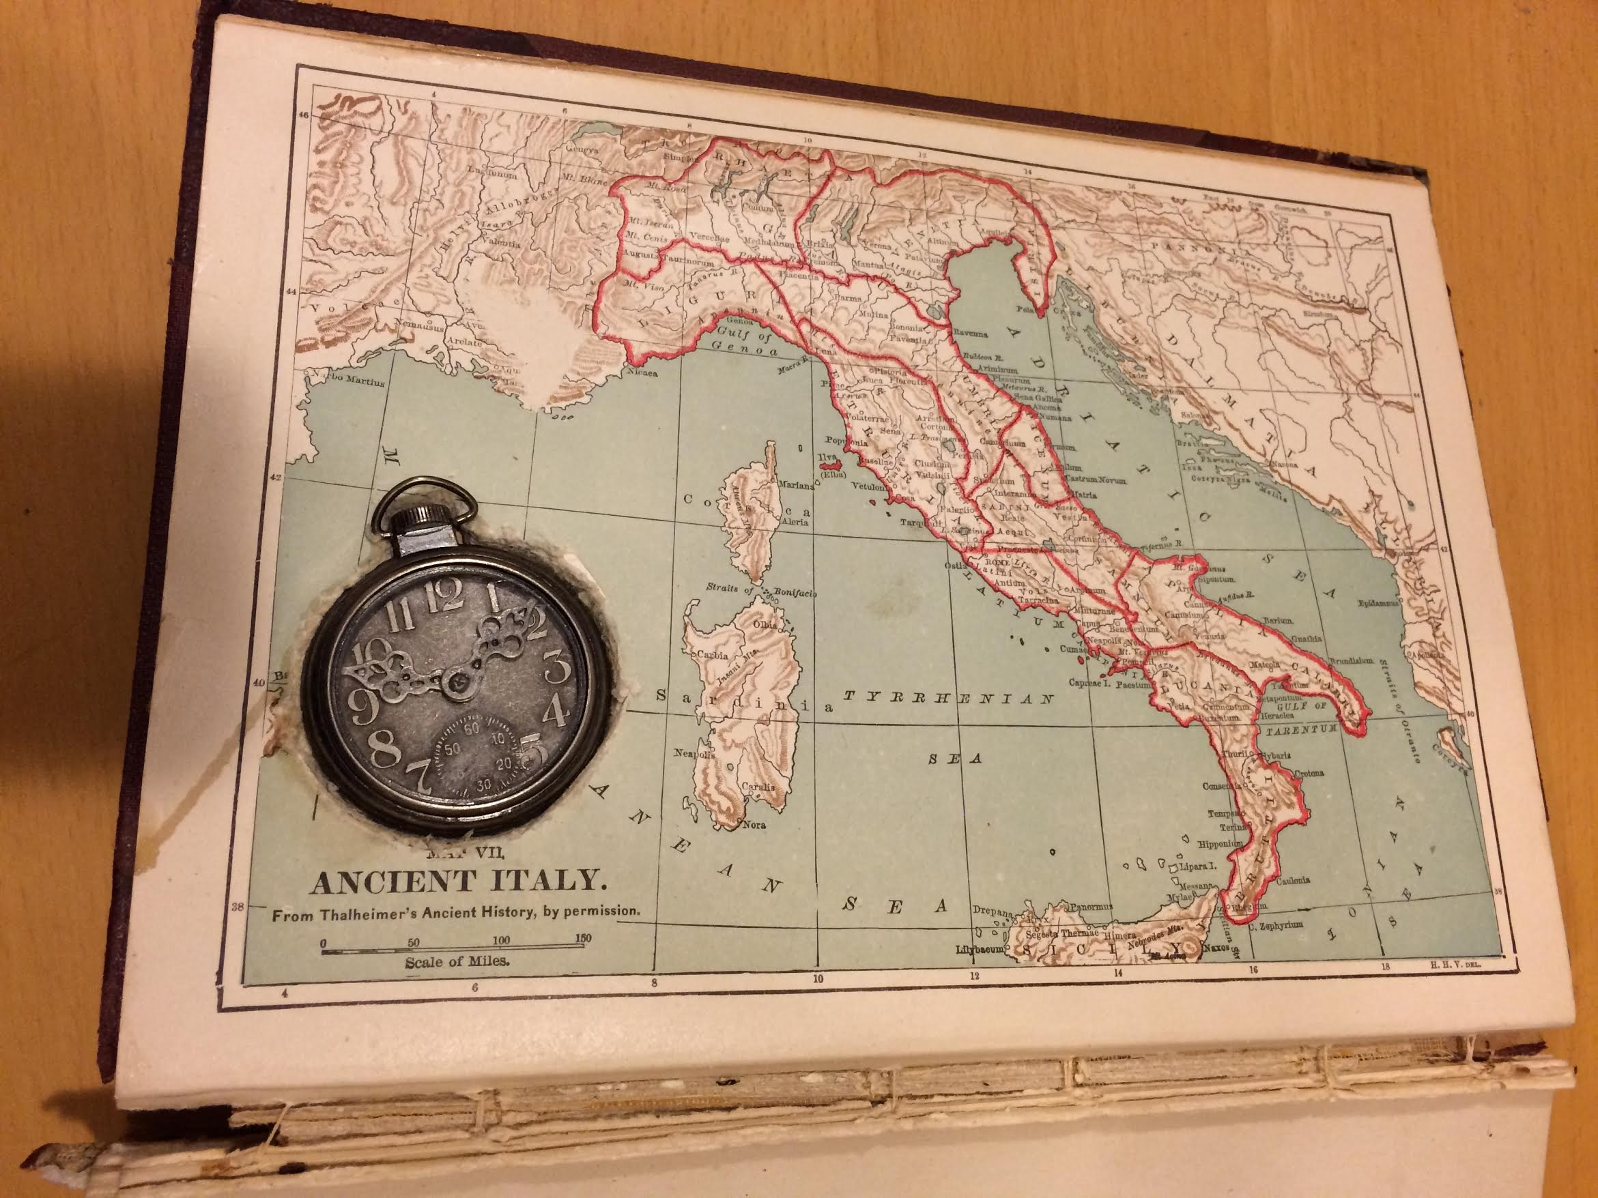
Surprises
Desire for guidance
Artistically inclined
Notes:
Chrystal

Slide 11
Inferences & Analysis

Slide 12
SAY
THINK
Feels like she needs to visualize every hole and know every angle of the course
“Visualization is everything”
“Everything is all on you”
Has to find her own way and be independent
“Professors will sometimes shut down my ideas without fully understanding the visualization I have for the final product.”
“I need to be my own disciplinarian”
Likes to think and plan projects out before starting the creation process
Very independent and career oriented
“It’s so sad. I have no life and no friends”
“I’m gonna do the thing that no one else does”
DO
FEEL
Dives in head first to learn something new
High stress since sponsors demand high performance
Loneliness from a packed and demanding schedule
Takes inspiration from surroundings, art books, museums, and online
Watches a ton of golf videos
Anxious to get past the design process and start working on the project
Isolated in a foreign country
Seeks isolated places to work
Starts design process by sketching/doodling
Notes:
Each color represents a different person

Slide 13
Analysis
Very different people, yet have common attributes
Highly independent individuals
Stress now → Reward later
Do we want to alleviate the stress they’re feeling or is it a part of the learning and growing process?
Common Theme: Needing Guidance
Notes:
And in summary, we interviewed a lot of different people but were all connected by a common need of wanted guidance.

Slide 14
Thank you!

